Slide 1


Introduction to Statistical Methods
BITS Pilani
Pilani|Dubai|Goa|Hyderabad
Team ISM
Slide 1 of 275 | Prof.Gangaboraiah PhD (Stats) Former Professor of Statistics | KIMS, B’lore

Slide 2
Session – 11
Correlation Analysis
(Covariance, Correlation, Rank Correlation)
(Session 11: 12th /13th February 2022)

Slide 3
Contact session | List of topic | References
CS - 11 | Covariance, Correlation, Rank Correlation | T1: Chapter 12 & 13

Slide 4

Introduction
Univariate population: The population consisting of only one variable.
Here, statistical measures are suffice analyze data.
For univariate data, the usual way of analysis is to describe the data by computing Measures of central tendency
Mean
Median
Mode
Temperature | 20 | 30 | 21 | 18 | 23 | 45 | 52
|

Slide 5
The extent of variability in univariate case is measured by calculating the following
Range
Standard Deviation
Coefficient of variation
Quartiles etc
|

Slide 6
Bivariate population: Here, the data happen to be on two variables.
Multivariate population: If the data happen to be one more than two variable.
…If we add another variable say viscosity in addition to Pressure, Volume or Temperature?
Pressure | 1 | 1.1 | … | 0.8
Temperature | 36 | 42 | … | 30

Slide 7
In case of bivariate and multivariate populations, usually, we have to answer two types of questions:
Q1: Does there exist correlation (i.e., association) between two (or more) variables?
If yes, of what degree?
Q2: Is there any cause and effect relationship between the two variables (in case of bivariate population) or one variable in one side and two or more variables on the other side (in case of multivariate population)?
If yes, of what degree and in which direction?
To find solutions to the above questions, two approaches are known.
Correlation Analysis
Regression Analysis

Slide 8
Correlation Analysis

Slide 9
Example: Wage Data
A large data regarding the wages for a group of employees from the western region of a country is given.
In particular, we wish to understand the following relationships:
Employee’s age and wage: How wages vary with ages?
Calendar year and wage: How wages vary with time?
Employee’s age and education: Whether wages are anyway related with employees’ education levels?

Slide 10
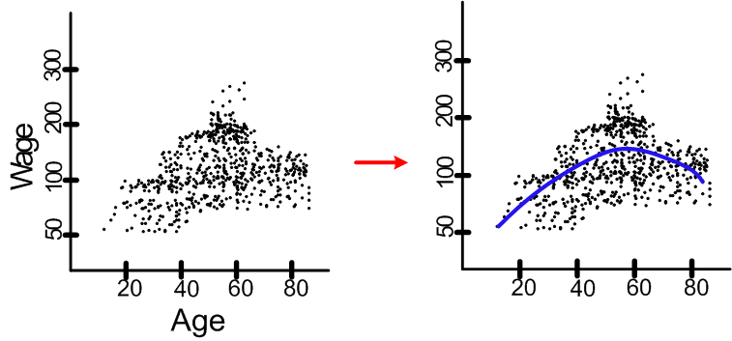
Case I. Wage versus Age
Employee’s age and wage: How wages vary with ages?
Interpretation: On the average, wage increases with age until about 60 years of age, at which point it begins to decline.

Slide 11
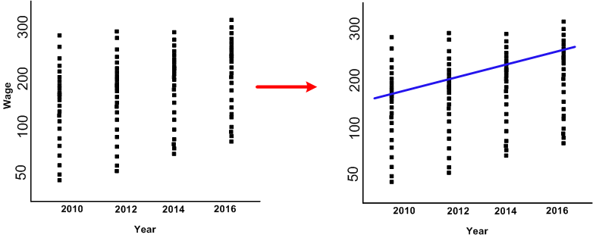
Case II. Wage versus Calendar
Wage and calendar year: How wages vary with years?
.
Interpretation: ?

Slide 12
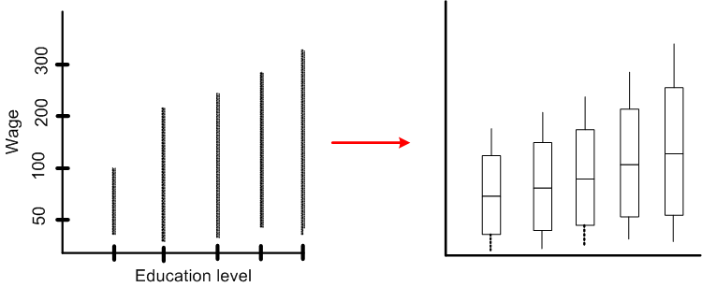
Case III. Wage versus Age
Wage and education level: Whether wages vary with employees’ education levels?
Interpretation: ?

Slide 13
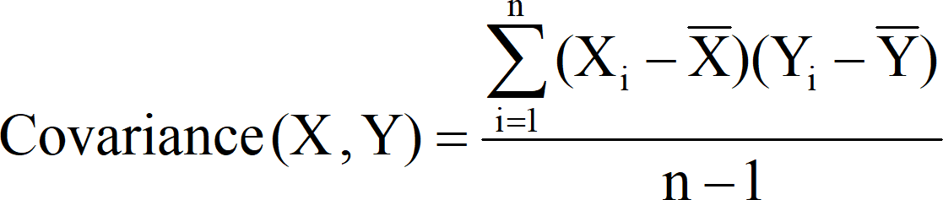
Covariance
The statistical technique used for studying
the existence and extent of relationship among 2 or more variables is through Covariance
|

Slide 14
So in bivariate and multivariate case, the statistical technique used for studying the existence of relationship between all variables is through Covariance.
|

Slide 15
Covariance signifies the direction of the linear relationship between the two variables. By direction we mean if the variables are directly proportional or inversely proportional to each other. (Increasing the value of one variable might have a positive or a negative effect on the value of the other variable).
|

Slide 16
The values of covariance can be any number between the two opposite infinities. Also, it’s important to mention that covariance only measures how two variables change together, not the dependency of one variable on another one.
|

Slide 17
The upper and lower limits for the covariance depend on the variances of the variables involved. These variances, in turn, can vary with the scaling of the variables. Even a change in the units of measurement can change the covariance. Thus, covariance is only useful to find the direction of the relationship between two variables and not the magnitude.
|

Slide 18
If X₁ and X₂ are two variables, the covariance between X₁ and X₂ is defined as
n
∑(X₁ − X1 )(X₂ − X2 )
Cov(X₁, X₂ ) = ^{i=1}
n −1
|

Slide 19
If X₁, X₂, …, X_{n} are n variables, then the Covariance between these n variables is the Variance – Covariance matrix given by
. . .
ο . . . σ
. . . .
. . . .
. . . .
ο _{n 2} . . .
where
⎡^{σ}11 ^{σ}12
^{σ}12 ⎤
⎢_{σ}
⎥
2n _{⎥ σ ij = ⎨}
⎧Variance, for i = j
⎢
21 22
. ⎥
. ⎥
⎩Covariance, for i ≠ j
Σ = ⎢ .
⎢ .
All diagonal elements in the
⎢
⎥
variance-covariance matrix are variances and off diagonal elements are covariances.
Σ is a symmetric matrix.
⎢ .
. ⎥
⎢
⎥
⎢⎣^{σ} n1
^{ο} n1 ⎥⎦
|

Slide 20
Even though the covariance explains the relationship between two or more variables, the units the measurement of variable is attached with the value of the covariance. If they have different unit of measurements, based on the sign it is possible to say whether they are related or not, but the degree (strength) of relationship is not possible to decide based on the value of covariance due to different units of measurement.
|

Slide 21
Example 1 :
Find the covariance between age (months) and weight (kgs) for the following data
Age (years) | 7 | 6 | 8 | 5 | 6 | 9
Weight (kgs) | 12 | 8 | 12 | 10 | 11 | 13
|

Slide 22
Solution -1
Age (yrs) (X) | Weight (kgs) (Y) | (X − X) | (Y − Y) | (X − X)(Y − Y)
5 | 20 | -2 | -3 | 6
4 | 18 | -3 | -5 | 15
7 | 23 | 0 | 0 | 0
10 | 32 | 3 | 9 | 27
8 | 26 | 1 | 3 | 3
8 | 25 | 1 | 2 | 2
∑X = 42 | ∑X = 144 |  |  | ∑(X − X)(Y − Y) = 53
Cov(X, Y) = ⁵³ = 10.6 years.kgs → Interpret this answer !
5
|

Slide 23
Covariance based on Probability distribution.
If X and Y are two random variables with probability mass function p(x)/ probability density function f(x), then the covariance between X and Y
Cov (X, Y) = E[(X-µ_{X})(Y-µ_{Y})] = E(XY) – E(X)E(Y)
where E(X) = µ_{X} and E(Y) = µ_{Y} are the means of X and Y.
|

Slide 24
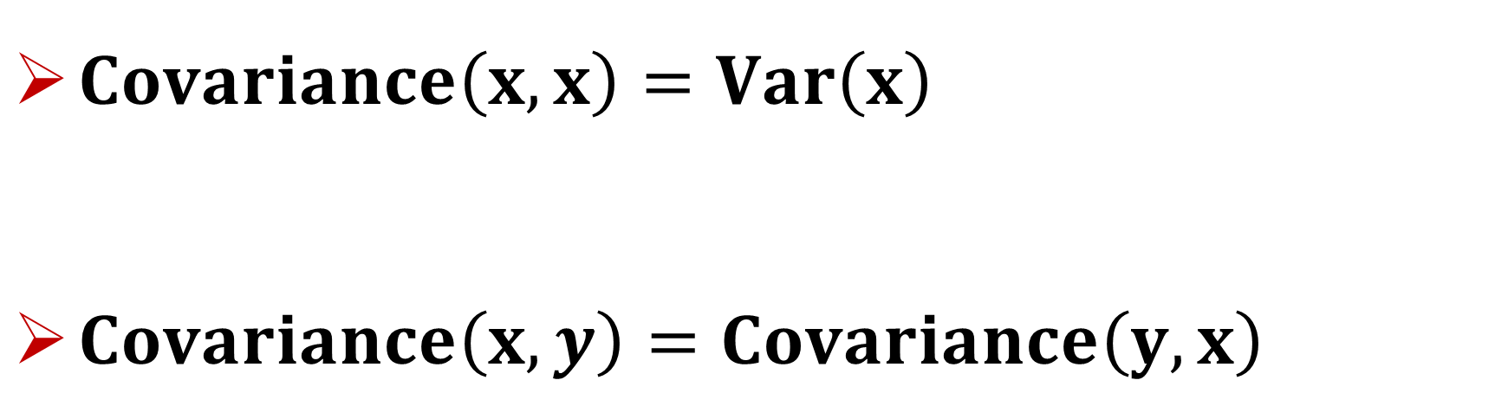
$Covariance\left(x,x\right)=Var\left(x\right)$
$Covariance\left(x,y\right)=Covariance\left(y,x\right)$
|

Slide 25
Application of Covariance.
1. Multivariate linear regression:
If there a dependent variable and n independent variables, to find out the relationship between these (n+1) variables, a variance – covariance matrix will be helpful.
|

Slide 26

Statistical Methods for Data Sciences
Correlational Analysis
Covariance
Application of Covariance.
2. Time series:
In the given series of data over the time, it helps in finding the autocorrelation at different time lags.
For example, if X_{t} , X_{t} , . . . , X_{t} denote the time series
1 2 n
data over a given period, then the autocovariance
|

Slide 27
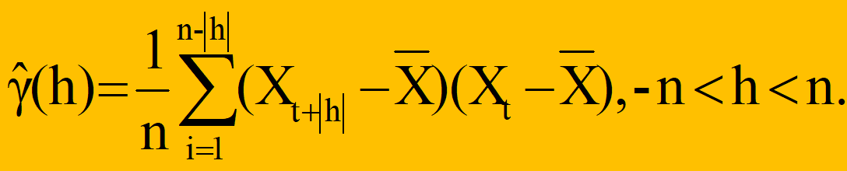
Application of Covariance. at lag h is given by
γ_{X}(t+h, t) = Cov (X_{t+h}, X_{t})
For example, if X_{t1}, X_{t2}, . . . , X_{tn} denote the time series data over a given period, then the auto-covariance.
The auto-covariance at lag h is then given by
|

Slide 28
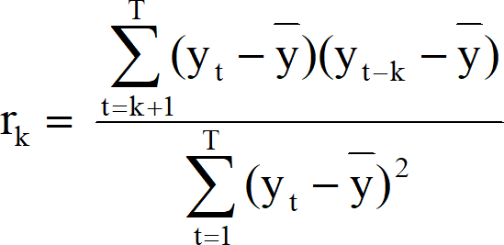
Application of Covariance.
With the help of auto-covariance, the autocorrelation is given by
|

Slide 29
Application of Covariance.
2. Principal Component Analysis (PCA):
PCA is simply described as “diagonalizing the covariance matrix”. What does diagonalizing a matrix mean in this context? It simply means that we need to find a non- trivial linear combination of our original variables such that the covariance matrix is diagonal.
|

Slide 30
When this is done, the resulting variables are uncorrelated, i.e. independent. The computation of the linear combinations of the original variables, called the ’principal components’.
Let A be a variance – covariance matrix and X be a vector of variables the Ax = λx, where λ is a scalar.
|

Slide 31
Calculate the eigenvalues and the corresponding eigenvectors of the covariance of the matrix A. If an eigenvalue computed in PCA is large, then the corresponding eigenvector (principal component) is important in describing the underlying data dependencies.
|

Slide 32
If the eigenvalue is near zero, that principal component is relatively unimportant and the data depend primarily on fewer components than there are measurement types. We merely need the machinery of eigenvectors and covariance matrices in order to find linear combinations of our original variables that are uncorrelated.
|

Slide 33
Karl Pearson’s Correlation coefficient
To overcome this, Karl Pearson’s suggestion was to divide the covariance of the variables by their respective standard deviations. The ratio of covariance to the product of standard deviations is called Karl Pearson’s product moment correlation, which is free of unit of measurement.
|

Slide 34
Karl Pearson’s product moment correlation returns a numerical value, popularly known as Coefficient of Correlation, denoted by ‘r’
Correlation coefficient is a statistic that assesses the strength and direction of relationship of two continuous variables
|

Slide 35
Simple correlation
Partial correlation
Multiple correlation
|

Slide 36

Measures of Correlation
Mathematically the following measures are used to find out the degree of relationship between the variables
♦ Karl Pearson’s product moment correlation
♦ Spearman’s rank correlation
The numerical value obtained by the above methods is called correlation coefficient
|

Slide 37
Simple Correlation coefficient
Karl Pearson’s product moment correlation or
product moment correlation is also called simple correlation coefficient, denoted by ‘r’
It measures the nature and strength of relationship between two variables of the quantitative type.

Slide 38
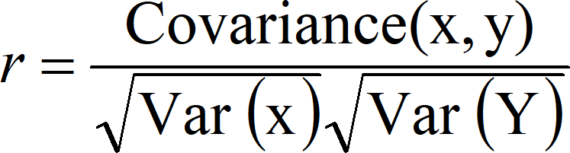
Formula for computing Karl Pearson’s correlation coefficient (r) is standardised covariance (unit less)

Slide 39
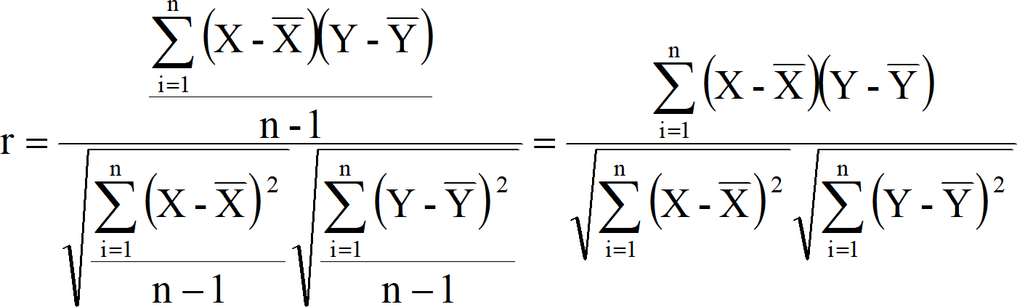
|

Slide 40
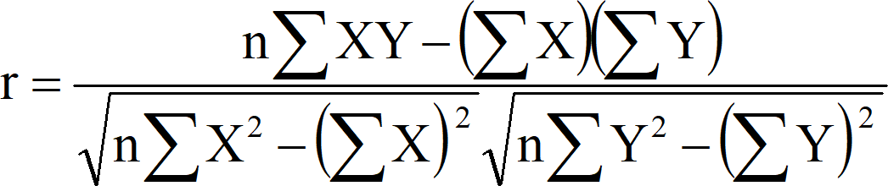
In general for computation purpose the following formula can be used
|

Slide 41
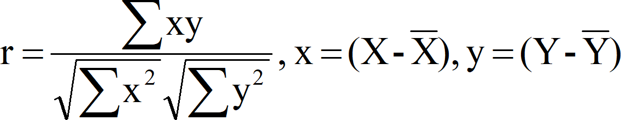
Karl Pearson’s Correlation coefficient
Or alternatively we can use
|

Slide 42
The sign of ‘r’ denotes the nature of association
The value of ‘r’ denotes the strength of association.
|

Slide 43
Simple Correlation coefficient
If the sign is +ve this means the relation is direct (an
increase in one variable is associated with an increase in the other variable and a decrease in one variable is associated with a
decrease in the other variable).
If the sign is -ve this means an inverse or indirect relationship (an increase in one variable is associated with a decrease in the other).
|

Slide 44
Simple Correlation coefficient
The value of r ranges between ( -1) and ( +1), i.e., -1 ≤ r ≤ +1
The value of r denotes the strength of the association as illustrated by the following diagram.
|

Slide 45

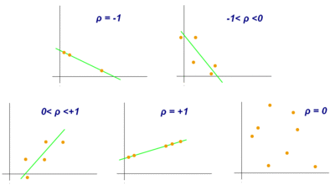
Simple Correlation coefficient
Karl Pearson’s correlation coefficient = r =
|

Slide 46
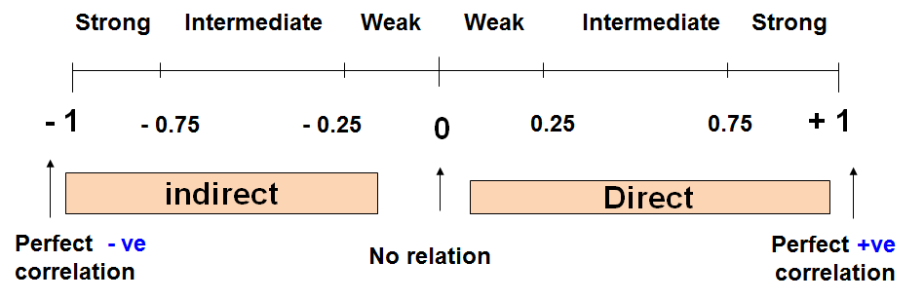
|

Slide 47
Simple Correlation coefficient
r = - 1 ⇒ Perfect negative correlation
0.99 to - 0.76 ⇒ Strong negative correlation
0.75 to - 0.26 ⇒ Intermediate (Moderate) negative correlation
0.25 to 0 ⇒ Weak negative correlation r = 0 ⇒ Zero correlation
0 to 0.25 ⇒ Weak positive correlation
0.26 to 0.75 ⇒ Intermediate (Moderate) positive correlation
0.76 to 0.99 ⇒ Strong positive correlation r = = 1 ⇒ Perfect positive correlation
|

Slide 48
Example
Serial No | Age (yrs) | Weight (Kg)
1 | 7 | 12
2 | 6 | 8
3 | 8 | 12
4 | 5 | 10
5 | 6 | 11
6 | 9 | 13
|

Slide 49
Solution
Sl no. | Age (yrs) (X) | Wt (Kg) (Y) | XY | _{X}2 | _{Y}2
1 | 7 | 12 | 84 | 49 | 144
2 | 6 | 8 | 48 | 36 | 64
3 | 8 | 12 | 96 | 64 | 144
4 | 5 | 10 | 50 | 25 | 100
5 | 6 | 11 | 66 | 36 | 121
6 | 9 | 13 | 117 | 81 | 169
Total | ∑X=41 | ∑Y=66 | ∑XY= 461 | ∑X²= 291 | ∑Y²= 742
|

Slide 50
Karl Pearson’s Correlation coefficient
𝑛 ∑ 𝑋𝑌 − (∑ 𝑋)(∑ 𝑌)
𝑛 ∑ 𝑋! − ∑ 𝑋 ! 𝑛 ∑ 𝑌! − ∑ 𝑌 !
𝑟 =
6 ∗ 461 − 41 ∗ 66
6 ∗ 291 − (41)! 6 ∗ 742 − (66)!
𝑟 =
r = 0.759 (Positive (Direct) strong correlation)
|

Slide 51
Karl Pearson’s Correlation coefficient
Example: Relationship between anxiety and test Scores
Anxiety (X) | Test score (Y) | _{X}2 | _{Y}2 | XY
10 | 2 | 100 | 4 | 20
8 | 3 | 64 | 9 | 24
2 | 9 | 4 | 81 | 18
1 | 7 | 1 | 49 | 7
5 | 6 | 25 | 36 | 30
6 | 5 | 36 | 25 | 30
∑X = 32 | ∑Y = 32 | ∑X² = 230 | ∑Y² = 204 | ∑XY= 129
|

Slide 52
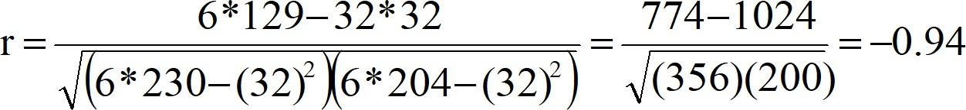
s
Karl Pearson’s Correlation coefficient
Correlational Analysis
𝑛 ∑ 𝑋𝑌 − (∑ 𝑋)(∑ 𝑌)
𝑛 ∑ 𝑋! − ∑ 𝑋 ! 𝑛 ∑ 𝑌! − ∑ 𝑌 !
𝑟 =
r = - 0.94 (Negative (Indirect) strong correlation )
|

Slide 53
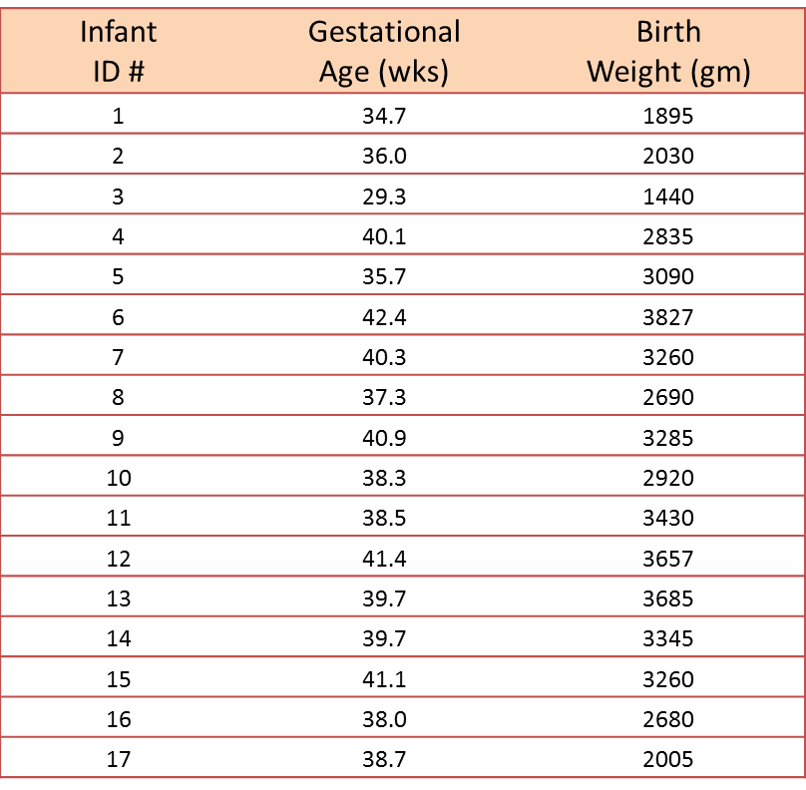
Example : A small study is conducted involving 17 infants to investigate the association between gestational age at birth, measured in weeks, and birth weight, measured in grams.

Slide 54




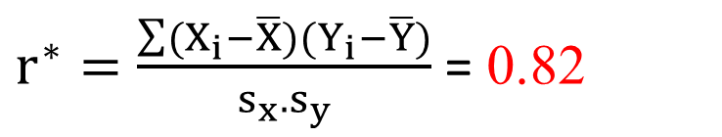
Solution :
In this example, birth weight is the dependent variable and gestational age is the independent variable. Thus Y = birth weight and X = gestational age.
For the given data, it can be shown the following
$r^{∗}=\frac{\sum{(X_{i}−\overline{X})(Y_{i}−\overline{Y})}}{s_{x}.s_{y}}$ = 0.82
Conclusion: The sample’s correlation coefficient indicates a strong positive correlation between Gestational Age and Birth Weight.

Slide 55
Spearman’s Rank Correlation coefficient
It is a non-parametric measure of correlation.
This procedure makes use of the two sets of ranks that may be assigned to the sample values of x and Y.
|

Slide 56
Spearman’s Rank Correlation coefficient
Spearman Rank correlation coefficient could be computed in the following cases:
Both variables are quantitative.
Both variables are qualitative ordinal.
One variable is quantitative and the other is qualitative ordinal.
|

Slide 57
Spearman’s Rank Correlation coefficient
Rank the values of X with the smallest value as rank 1,
♦ next value as rank 2 and so on.
♦ assign rank n for the largest value.
♦ If there any tied values assign average ranks.
♦ The ranks can be assigned in the reverse order
♦ Rank the values of Y as done for X separately.
|

Slide 58
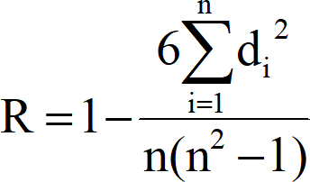
♦ Compute the value of d_{i} for each pair of observation
by subtracting the rank of Y_{i} from the rank of X_{i}
♦ Square each d_{i} and compute ∑d² which is the sum of
i
the squared values.
Where d = R_{x} – R_{y}, R_{x} = Rank of X
values; R_{y} Rank of Y values
The value of R denotes the magnitude and nature of association giving the same interpretation as simple r.
Slide 47 of 275 | Prof.Gangaboraiah PhD (Stats) Former Professor of Statistics |

Slide 59
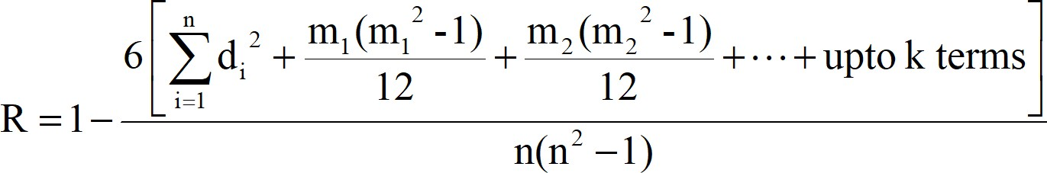
Spearman’s Rank Correlation coefficient
In case of tied observation, the formula for calculation of R is
Where m₁, m₂, ..., is the number of times a value of X or Y repeats
|

Slide 60
Spearman’s Rank Correlation coefficient
Example
In this example, we will use the raw data in the table
below to calculate the correlation between the IQ of a person with the number of hours spent in front of TV per
week
Intelligent Quotient | 106 | 86 | 100 | 101 | 99 | 103 | 97 | 113 | 112 | 110
Hours of TV watching | 7 | 0 | 27 | 50 | 28 | 29 | 20 | 12 | 6 | 17
|

Slide 61
Solution
Intelligent Quotient (X) | Hours of TV watching (Y) | Rank X (Rx) | Rank Y (Ry) | d = Rx - Ry | _{d}2
86 | 0 | 1 | 1 | 0 | 0
97 | 20 | 2 | 6 | − 4 | 16
99 | 28 | 3 | 8 | − 5 | 25
100 | 27 | 4 | 7 | − 3 | 9
101 | 50 | 5 | 10 | − 5 | 25
103 | 29 | 6 | 9 | − 3 | 9
106 | 7 | 7 | 3 | 4 | 16
110 | 17 | 8 | 5 | 3 | 9
112 | 6 | 9 | 2 | 7 | 49
113 | 12 | 10 | 4 | 6 | 36
|

Slide 62
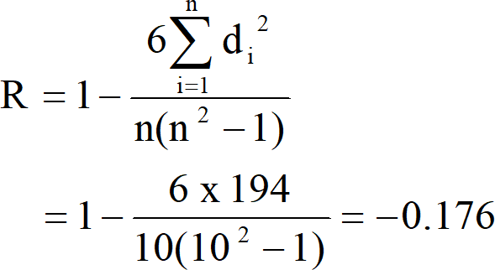
Spearman’s Rank Correlation coefficient
With d ² found, we can add them to find ∑d ² = 194.
i i
The value of n is 10. So these values can now be substituted back into the equation, which evaluates to
This low value shows that there is a negative correlation between IQ and hours spent watching TV is very low.
|

Slide 63
Spearman’s Rank Correlation coefficient
Example :
Find rank correlation between distance and price
Convenience Store | 1 | 2 | 3 | 4 | 5 | 6 | 7 | 8 | 9 | 10
Distance (m) | 50 | 175 | 175 | 375 | 425 | 580 | 710 | 790 | 890 | 980
Price of 50cl bottle (Rs) | 1.80 | 1.20 | 2.00 | 1.00 | 1.00 | 1.20 | 0.80 | 0.60 | 1.00 | 0.85
|

Slide 64
Solution
Convenience Store | Distance (m) |  | Rank distance | Price of 50cl bottle (Rs) | Rank price | Difference between ranks (d) | d²
1 | 50 |  | 10.00 | 1.80 | 2.00 | 8.00 | 64.00
2 | 175 |  | 8.50 | 1.20 | 3.50 | 5.00 | 25.00
3 | 175 |  | 8.50 | 2.00 | 1.00 | 7.50 | 56.25
4 | 375 |  | 7.00 | 1.00 | 6.00 | 1.00 | 1.00
5 | 425 |  | 6.00 | 1.00 | 6.00 | 0.00 | 0.00
6 | 580 |  | 5.00 | 1.20 | 3.50 | 1.50 | 2.25
7 | 710 |  | 4.00 | 0.80 | 9.00 | - 5.00 | 25.00
8 | 790 |  | 3.00 | 0.60 | 10.00 | - 7.00 | 49.00
9 | 890 |  | 2.00 | 1.00 | 6.00 | - 4.00 | 16.00
10 |  | 980 | 1.00 | 0.85 | 8.00 | - 7.00 | 49.00
|

Slide 65
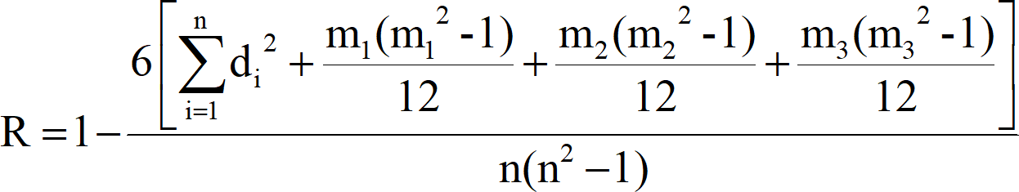
Spearman’s Rank Correlation coefficient
In this example, the value 175 of X has repeated twice and therefore m₁ is taken as 2; two values of Y have repeated namely, 1 has repeated thrice and 1.20 has repeated twice. By taking m₂=3 and m₃=2 and substituting in the formula, we

Slide 66
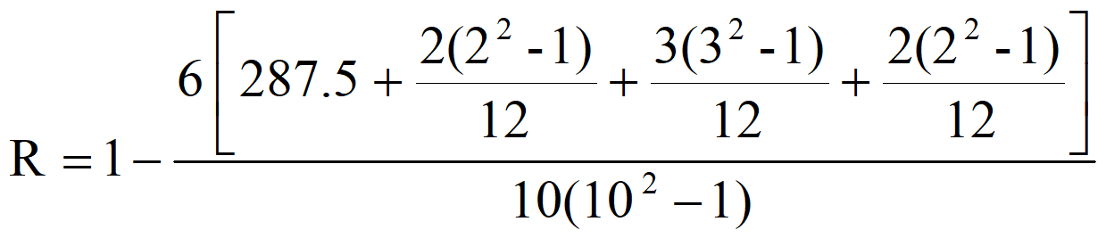

Spearman’s Rank Correlation coefficient
2
By substituting the value of m₁ = 2, m₂=3 and m₃=2 and ∑d_{i} =
287.5, we get
This shows that there a moderate degree negative correlation between the distance and the price.
|

Slide 67
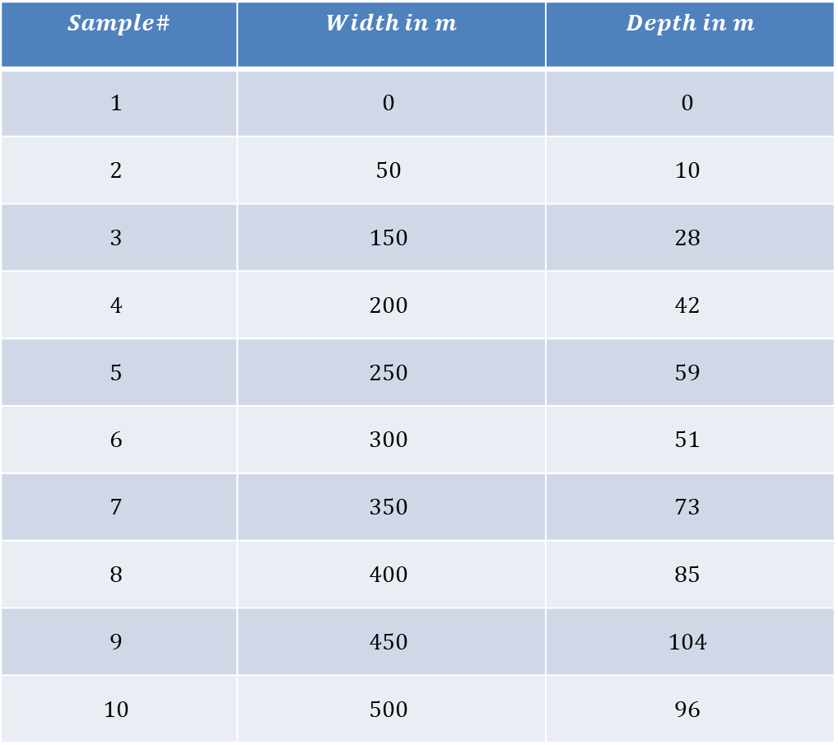
Example :
Find rank correlation between width and depth of a river.
$$Sample\#$$ | $$Width in m$$ | $$Depth in m$$
$$1$$ | $$0$$ | $$0$$
$$2$$ | $$50$$ | $$10$$
$$3$$ | $$150$$ | $$28$$
$$4$$ | $$200$$ | $$42$$
$$5$$ | $$250$$ | $$59$$
$$6$$ | $$300$$ | $$51$$
$$7$$ | $$350$$ | $$73$$
$$8$$ | $$400$$ | $$85$$
$$9$$ | $$450$$ | $$104$$
$$10$$ | $$500$$ | $$96$$

Slide 68

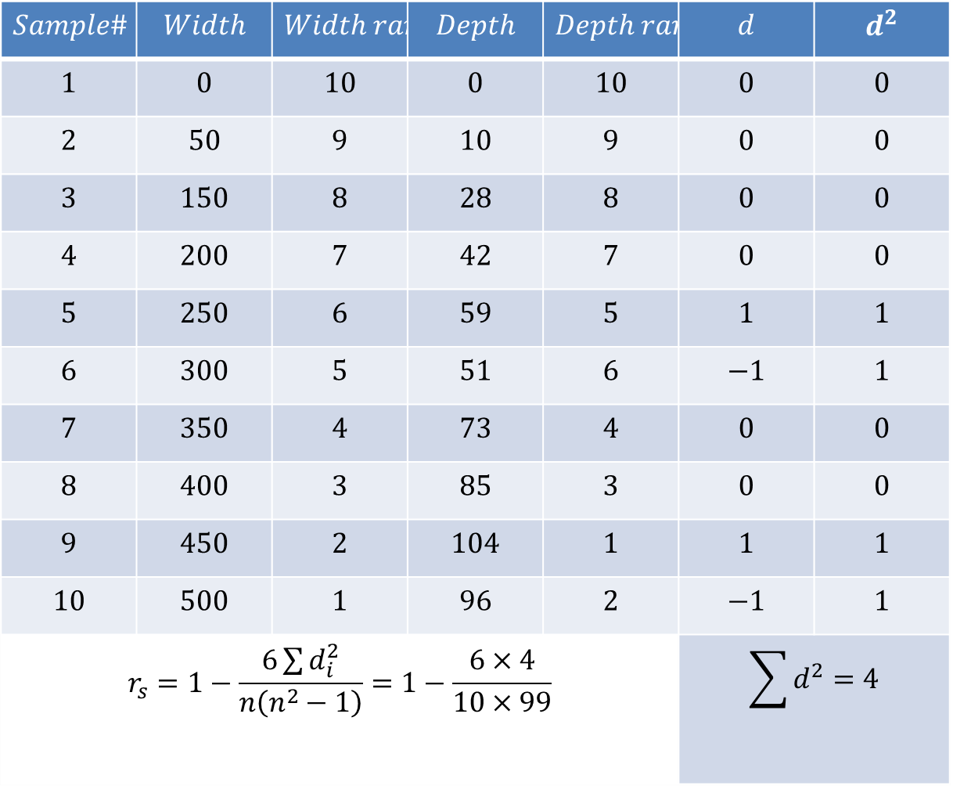
Solution
$$Sample\#$$ | $$Width$$ | $$Width rank$$ | $$Depth$$ | $$Depth rank$$ | $$d$$ | $$d^{2}$$
$$1$$ | $$0$$ | $$10$$ | $$0$$ | $$10$$ | $$0$$ | $$0$$
$$2$$ | $$50$$ | $$9$$ | $$10$$ | $$9$$ | $$0$$ | $$0$$
$$3$$ | $$150$$ | $$8$$ | $$28$$ | $$8$$ | $$0$$ | $$0$$
$$4$$ | $$200$$ | $$7$$ | $$42$$ | $$7$$ | $$0$$ | $$0$$
$$5$$ | $$250$$ | $$6$$ | $$59$$ | $$5$$ | $$1$$ | $$1$$
$$6$$ | $$300$$ | $$5$$ | $$51$$ | $$6$$ | $$−1$$ | $$1$$
$$7$$ | $$350$$ | $$4$$ | $$73$$ | $$4$$ | $$0$$ | $$0$$
$$8$$ | $$400$$ | $$3$$ | $$85$$ | $$3$$ | $$0$$ | $$0$$
$$9$$ | $$450$$ | $$2$$ | $$104$$ | $$1$$ | $$1$$ | $$1$$
$$10$$ | $$500$$ | $$1$$ | $$96$$ | $$2$$ | $$−1$$ | $$1$$
$$r_{s}=1−\frac{6\sum{d_{i}^{2}}}{n\left(n^{2}−1\right)}=1−\frac{6×4}{10×99}$$ |  |  |  |  | $$\sum{d^{2}=4}$$
$$r_{s}=0.9757$$
Interpretation: …?

Slide 69
Scattered diagram
Scattered diagram is one of the ways of
finding the extent of relationship between two quantitative variables. However, this method will only indicate that there is a relationship between two variables but, not the extent to which they are related.
|

Slide 70

Scattered diagram
Rectangular coordinate
♣ Two quantitative variables
♣ One variable is called independent (X) and the
second is called dependent (Y)
Y
* *
♣ Points are not joined
♣ No frequency table
*
X
|

Slide 71
Scattered diagram
The pattern of data is indicative of the type of relationship between your two variables:
Positive relationship
Negative relationship
No relationship
|

Slide 72
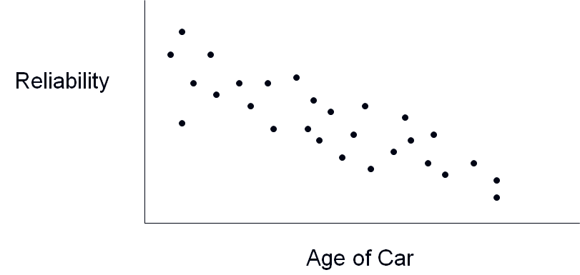
Scattered diagram-Negative correlation
|

Slide 73
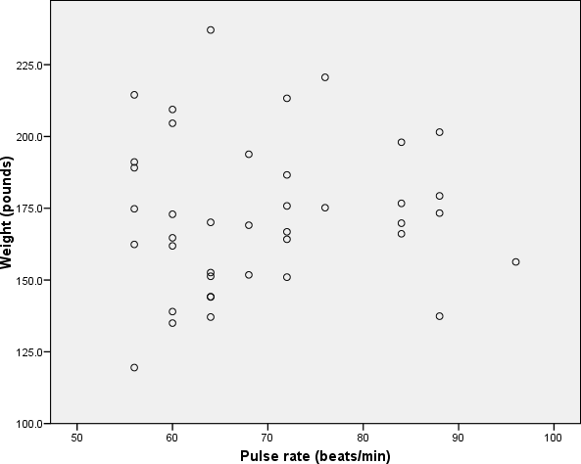
Scattered diagram-Zero correlation
|

Slide 74
Scattered diagram- Positive correlation
18
16
14
12
10
8
6
4
2
0
Height in CM
0
10
20
30
40 50
Age in Weeks
60
70
80
90
|

Slide 75
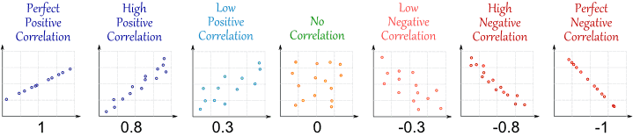
Scattered diagram- Some specific cases
$$−1≤Correlation\left(x,y\right)≤+1$$

Slide 76
Scattered diagram – Example
Wt. (kgs) | 67 | 69 | 85 | 83 | 74 | 81 | 97 | 92 | 114 | 85
SBP (mmHg) | 120 | 125 | 140 | 160 | 130 | 180 | 150 | 140 | 200 | 130
SBP (MM Hg)
240
220
200
180
160
140
120
100
80
60
70
80
90
Weight (kgs)
100
110
120
|

Slide 77
Homework Problems
Q1) Consider the following data.
Expenditure (in 1000 Rs) | 30 | 70 | 40 | 20 | 10 | 40 | 10 | 20
Actual Sales(in 1000 Rs) | 10 | 16 | 19 | 14 | 17 | 16 | 13 | 18
For the above data,
i) Find coefficient of correlation between expenditure and actual sales. [Ans = 0.8108]
ii) Find rank correlation between expenditure and actual sales. [Ans = - 0.2424 ]
Q2) Find coefficient of correlation between X & Y.
X | 79 | 29 | 45 | 61 | 24 | 38 | 33 | 52 | 65 | 63 | 82 | 50
Y | 15 | 12 | 12 | 6 | 6 | 7 | 3 | 10 | 12 | 13 | 13 | 14
Ans = r= 0.59
Q3) Check whether X and Y are having any relation.
X | 12 | 14 | 15 | 17 | 17 | 16 | 16 | 15 | 14 | 14
Y | 52 | 52 | 57 | 62 | 67 | 67 | 67 | 62 | 62 | 52
Ans = r = 0.7866

Slide 78
Thank You
|

